Slide 1
<number>
Presentation for Mobile computing Lab

Slide 2


Presentation by
<number>
Md. Tahadur Rahman Tonmoy
ID:115
Section: 8A
Dept. of CSE, NUBTK
&
M. Ali Abrar Khan
ID:121
Section: 8A
Dept. of CSE, NUBTK

Slide 3
<number>
Project Title: Industrial network design in Packet Tracer and Employee Attendance System using static IP and MAC
Github link:
https://github.com/MAliAbrarKhan19/EAMS-IP-MAC-based-Employee-Attendance-Management-System.git

Slide 4
Part 1- Network Design
4
Network Design Tools :
Cisco Packet Tracer
Network Devices:
Routers:CISCO 2911 & CISCO 2901
Switches:
Servers: HTTP, DNS, Log Server
User PC,
Laptops,
Mobile Phones
Access Point Wirless

Slide 5
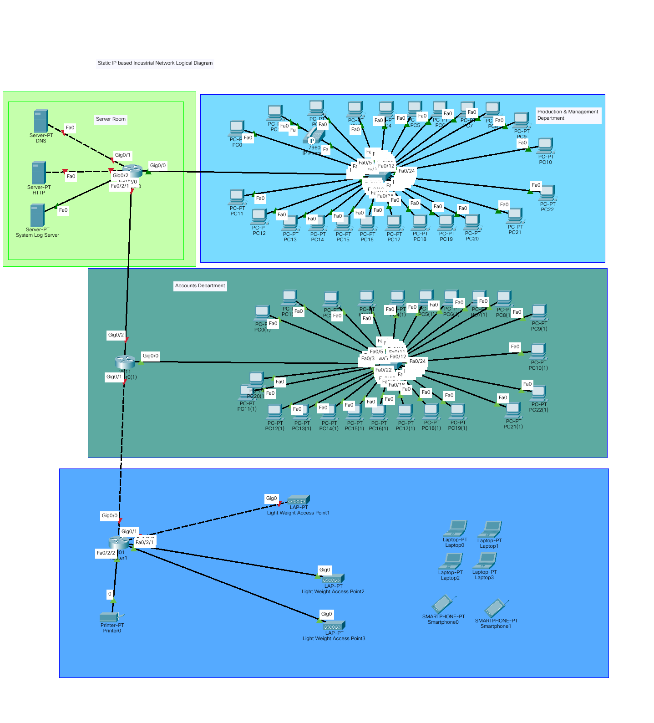
Part 1- Network Design
4

Slide 6
Part 1- Network Design
6
Network IP Subnetting Table:
IP Address: | 103.150.6.0 | CIDR Notation: /27 (Classless Inter-Domain Routing)
Subnet Mask : | 255.255.255.224 | IP Class : C
Total Number of Hosts: 32 | Number of Usable Hosts: 30
Subnets:
Network Address | Usable Host Range | Broadcast Address
103.150.6.0 | 103.150.6.1-103.150.6.30 | 103.150.6.31
103.150.6.32 | 103.150.6.33-103.150.6.62 | 103.150.6.63
103.150.6.64 | 103.150.6.65-103.150.6.94 | 103.150.6.95
103.150.6.96 | 103.150.6.97-103.150.6.126 | 103.150.6.127
103.150.6.128 | 103.150.6.129-103.150.6.158 | 103.150.6.159
103.150.6.160 | 103.150.6.161103.150.6.190 | 103.150.6.191

Slide 7
Part 2- Web Development
7
MAC & IP based Employee Attendance Management System
Design Tools :
HTML
CSS
Bootstrap
Development Tools :
PHP
MySQL
JavaScript

Slide 8
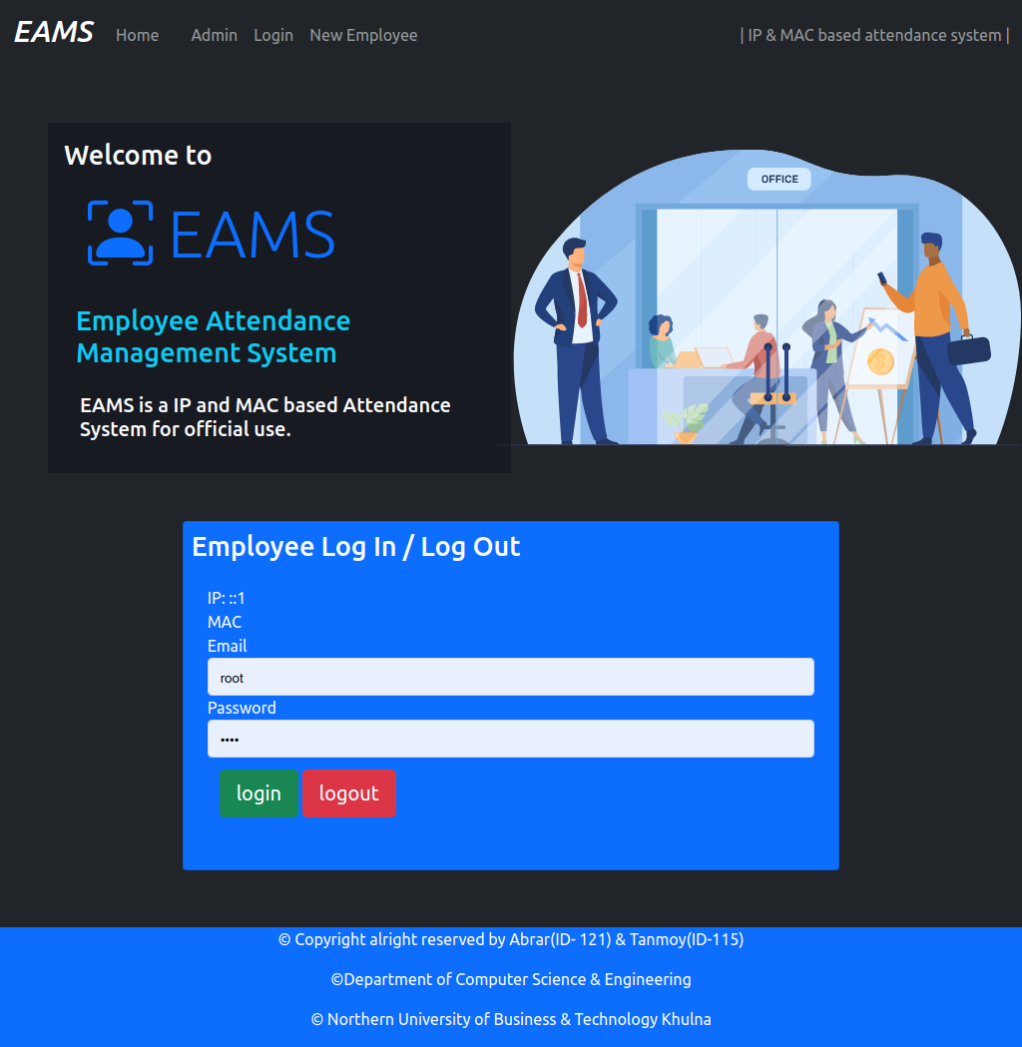
Part 2- Web Development
8
MAC & IP based Employee Attendance Management System
Employee’s can only give attendance from their PC only
The system will match both the
IP & MAC of the user with the
registered IP & MAC
Any attendance outside the
network will be recorded but
marked as NOT MATCHED.
So no one is able to cheat the
system

Slide 9
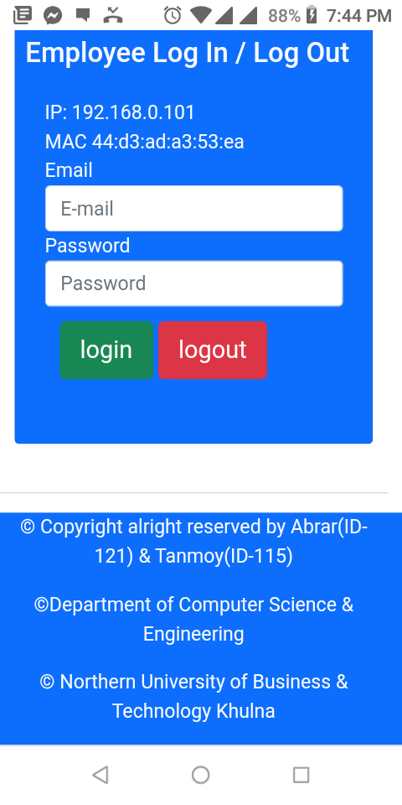
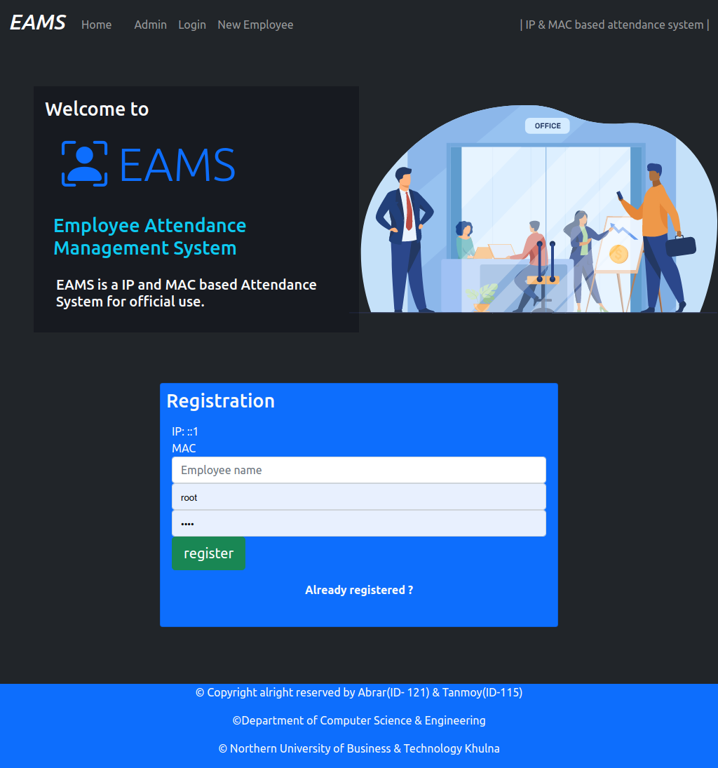
Part 2- Web Development MAC & IP based Employee Attendance Management System
8

Slide 10
THANK YOU....

